Slide 1
TrackVia Case Management
Architecture Design Authority
AML Program
Michael Mieczkowski
presentation Category: HIGH LEVEL DESIGN
*** UPDATE ***
Presentation seeking: approval
Presentation Date: 1st SEPTEMBER 2020
PROJECT STAGE: PLANNING PHASE
Presentation Version: 2.0

Slide 2
Architecture Design Review
PROJECT Overview
Is this a benefit to the organisation
Project Name
AML Program - TrackVia
Business Justification
The AML Business Team are facing challenges with enhanced government/regulatory oversight; and challenges with existing process & systems that have evolved over time with resulting functional duplication and workflow inefficiencies.
Cost
Time / Duration
CAR # / CASC Code
ROM Costing and Timeframe
In Dollars
6-12
In Months
$
Business Benefits
The AML Program of work will deliver the following capability / benefits:
New Case Management & Business Workflow capability - TrackVia
Enhanced AML Transaction Monitoring – Data Lake
New Patron Screening Repository – Factiva (Dow Jones)
Automation to minimise manual processes / double handling of data.
Business Owner
Kevin Houlihan
IT GM Owner
Nicola Bourke
Notes:
Replace this slide with the ‘One Pager’ if it is available. If presenting a high level design or detailed design then costs and timeframes should be included, even if they are estimates.

Slide 3
Architecture Design Review
BUSINESS VISION
TrackVia
Wholistic view of Patrons across properties
Ability to assign tasks
Ability to calculate customer risk ratings
Ability to attach documents
Ability to produce reports
Ability to maintain records
Ability to conduct ECDD
Ability to dispose/analyse transaction monitoring alerts
Ability to conduct Risk Assessments
Ability to store SOPs
Ability to maintain JRAM/PAMM minutes/actions
Eliminate manual processes
Ability to record SMR/TTR/IFTI related information
Ability to escalate to Senior Management
Refer to User Stories for further BRs
Ability to maintain the Jurisdictional Risk Tool
Dashboards
Customer Data from Data Lake /including delta
SLAs
BU Tasks
Transaction Monitoring Alerts
SLAs
Internal suspect activity referrals
Xml file to AUSTRAC
AML team initiated investigations
Daily Customer Screening (Factiva alerts)
Various Reports
Ongoing Customer Due Diligence
JRAM - Joint Risk Assessment Meeting
PAMM - Patron Activity Monitoring Meeting

Slide 4


Architecture Design Review
TTR (threshold transaction report)
SMR (suspicious matter reports)
IFTIs (international funds transfer instruction)
design overview: current
Austrac
P2P Integration (For Exclusions List per property)
TTR, SMR, IFTIs
Surveillance System Pelco (BRIS),
Dallimeier (GC),
Avigilon (SYD, QWB)
Add/Update Patron Case
TTR (xml, semi-automatic - waiting on Synkros CRs & data issues)
Compliance Reporting
AML Team
Email Notifications
Video Recording
Synkros
(SYD, GC, BRIS)
Protecht
Critical / High / Medium Risk
Patron Register
(excluded Patrons via manual incident report)
Patron
API (create first record)
CDW
Customer Incident Database (CID)
Asset Protection Team
(SYD, QLD) - data sync with
Synkros & CDW.
Patron List
Add/Update
Patron Case
Patron Check
Gaming
Transactions
Cognos
Reporting
AML Forms (& attachments)
Synkros Transactions
Master Exclusion List (Carded/Un-carded)
Protecht Patron wash list
Case Management
Incidents
Add/Update Patron Case
Add/Update Patron Case
TransWatch
Check
Patron
Check
Patron
Synkros Transactions
Patron Screening Extract
Surveillance Team
Security Team
SQL Server.
Case Management / Alerts
iBase Extract
iBase
Investigations Team
Daily Check
Patron
Factiva
World Check
Transaction Monitoring Engine
Multi-Source
Data Management
& Analysis
Global PEP Database
Global PEP Database
Data Warehouse
Manual Task Automated Interface
Notes:
Please provide an outline of what the solution will deliver, any options considered, and any issues, concerns, exceptions to architectural principles identified. The current solution vs future solution should be outlined here to highlight what changes are occurring and any impacts.

Slide 5
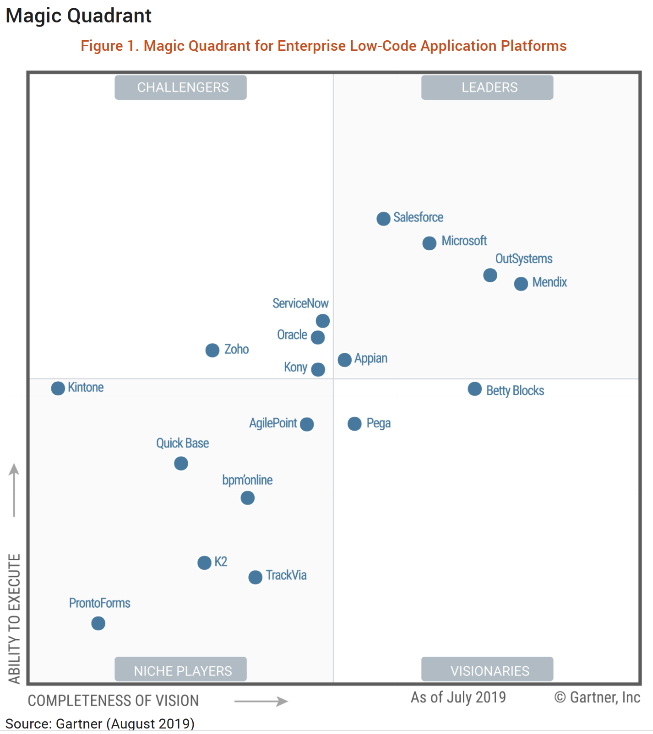
Architecture Design Review
low-code development platform
Cloud Low-Code Platform:
Provide teams across the organisation with one secure app-building platform.
Facilitate collaboration across teams, as well as across other departments.
Connect to other apps and software systems with TrackVia Integrations or Developer APIs.
Test and try app changes in a separate, sandbox environment.
Single Sign-On login authentication.
USA based servers (option for AU based servers).
TrackVia supports SSO and “Just In Time” user provisioning

Slide 6
Architecture Design Review
design overview: FUTURE
AML Team Add/update
Case: PEP, SMR, IFTIs, ECDD, OCDD etc
MDM
Patron API (Create new AML Patron record)
P1
Austrac Forms:
TTR (threshold transaction report)
SMR (suspicious matter reports)
IFTIs (international funds transfer instruction)
Master Patron List
Email Notifications
TrackVia (NEW)
Austrac
Critical / High / Medium Risk
AML Patron Register
Compliance Reporting
SYNKROS
(SYD, GC, BRIS)
A1
Surveillance Systems (Syd, Bris, GC, QWB)
Add/Update Patron Case
Employee Risk Register
EEIS Risk
Register
Create PEP, TM,TTR, SMR, IFTIs case
C1
Patron List
TTR (with auto open/closed case in TrackVia)
Video Recording
Case Management
Gaming
Transactions
AML Forms (& attachments)
Daily Patron wash list
W1
A2
Business Workflow
Manual AUSTRAC SMR Reports
Manual Add/Update Patron Case
Azure Data Lake
Flag Transaction as AML Positive in Data Lake
Real/Batch Alerts
iBase
Investigations Team
Factiva
Global PEP Database
C2
Transaction Monitoring Engine
Multi-Source
Data Management
& Analysis
News
W2
Data Warehouse
Daily Patron Wash
Power BI
Machine Learning
Case Data
Viewer
Manual Task Automated Interface Interface
##
Notes:
Please provide an outline of what the solution will deliver, any options considered, and any issues, concerns, exceptions to architectural principles identified. The current solution vs future solution should be outlined here to highlight what changes are occurring and any impacts.

Slide 7
Architecture Design Review
High Level Design
Impacts:
TrackVia to replace Protecht for AML Case Management / Workflow:
TrackVia the core AML system – Case Management
Move the Protecht Patron Register to TrackVia (decommission the Protecht AML component)
SSO integration for user login/authentication
Phase Out Transwatch / World Check systems:
Factiva to replace WorldCheck for Patron Screening.
Data Lake – New functions: Transactions monitoring, Real time alerts, machine learning
Phase out CDW:
Transition CDW capability to Data Lake.
New Integrations:
Ability to plug into additional PEP databases (e.g. Asia focused)
TrackVia integration with Austrac
MDM integration
Notes:
The example should be removed and replaced with the appropriate diagram and level of detail relevant to your presentation

Slide 8
Architecture Design Review
Patron Search Results (Example):
Data Architecture
KCMS | Protecht.ERM | Data Type
patronID | Patron ID | String
propertyID | Property ID | String
firstName | First Name | String
lastName | Last Name | String
DOB | Date of Birth | String
status | Status | String - 8=Casino Excluded, 0=Unknown, 1=Active, 2=Inactive, 3=Security Alert, 4=Credit Alert, 5=Probation, 6=Self-Excluded, 7=Duplicate
addressLine1 | Address Line 1 | String
addressLine2 | Address Line 2 | String
addressLine3 | Address Line 3 | String
addressPostCode | Post Code | String
addressCity | City | String
addressState | State | String
addressCountryCode | Country Code | String
addressStatus | Address Status | String - Preferred, Invalid, Do not Contact.
homePhoneNumber | Home Phone Number | String
homePhoneStatus | Home Phone Status | String - Preferred, Invalid, Do not Contact.
mobilePhoneNumber | Mobile Phone | String
 | Number
mobilePhoneStatus | Mobile Phone Status | String - Preferred, Invalid, Do not Contact.
TrackVia is the new system for AML Case Management and holds a repository of Critical, High & Medium Risk Patrons.
The Patron data is classified as PII i.e. “Sensitive” data.
Austrac SMR, TTR, IFTIs data is classified as “Sensitive” data
SSO has already been implemented to mitigate the end-user identity risk.
Cybersecurity will assist with assessing all risks with data transactions/ storage /business process as part of the end to end solution review i.e.
Data sovereignty review,
GDPR Compliance & Australian Privacy principles review.
System access vs data visibility to manage data risk.
System audit capability for you viewed/updated records.
Security assurance testing to be reviewed and scoped during the design phase.
Notes:
This must be completed even if there is no impact or change to the current architecture – A view of the data architecture in relation to the solution is required

Slide 9


Architecture Design Review
TrackVIA Integration
(with workato integration)
Microsoft
Azure
API G/W
&
Azure Function
(NEW)
TSEG Local Network
Note:
(1) MDM existing Public API, but the strategic direction is for Azure API G/W for enhanced security features.
(2) The TrackVia to TSEG email integration is yet to be defined.
(3) The vendor has submitted a proposal for Australia based servers (including Disaster Recovery)
(4) No API available, only HTTP post request.
#1
MDM
P1
Patron API Search.
REST
ESB
IBM AD
Critical / High /
Medium Risk
Patron Register
RESTful API
Case Management
W1
AML Patron Wash List
Azure Data Lake
REST
Business Workflow
C1
Create Case Types (s)
REST
Real/Batch Alerts
Note: AU Based Primary and Secondary Server
C2
Update TM Data
REST
#3
#2
A2
Manual SMR for Austrac
Transaction Monitoring Engine
Austrac
#4
Austrac Reporting
Submission
AUSTRAC Reports
Compliance Reporting
HTTP
A1
Data Warehouse
Key:
Factiva
Public
Internet
Global PEP Database
SFTP
W2
Machine Learning
Azure AD
SFTP
W3
Daily Patron Wash
Notes:
This must be completed even if there is no impact or change to the current architecture – A view of the infrastructure architecture in relation to the solution is required

Slide 10
Architecture Design Review
TrackVIA Integration – RELEASE PLAN - DRAFT
Release 1 (Critical):
P1 – MDM Patron API Search
C1 – TrackVia Create Case
C2 – Update Transaction Monitoring Case results
W1 – TrackVia Patron Wash Extract
W2 – Factiva Daily Patron Wash
Release 2 (Proposed):
A1 – Austrac Compliance Reporting
A2 – TrackVia manual SMR case submission to Austrac
NOTE: A more detailed conversations with TrackVia have concluded that workato is not required for the initial release as TSEG integration requirements can be achieved with direct API integrations between TrackVia and TSEG Azure Platform.

Slide 11
Architecture Design Review
TrackVIA LOCAL AWS Servers
TrackVia:
3 instances, 3 app servers, and 3 routers in High Availability
Instrument in TrendMicro & Crowdstrike anti-intrusion detection, host monitoring & vulnerability management software
System level system monitoring so we know the status of each machine, CPU, and memory usage
Redundant storage with 90 days rolling backups - taken nightly
Ability to restore within minutes
SIEM for log file monitoring & intrusion detection
3rd party site monitoring checking every 5 minutes for site reliability
Costs:
Standard Private Cloud: $45k/year USD
Large Private Cloud (more storage and computing power): $60k/year USD
SIEM - Security Information and Event Management

Slide 12

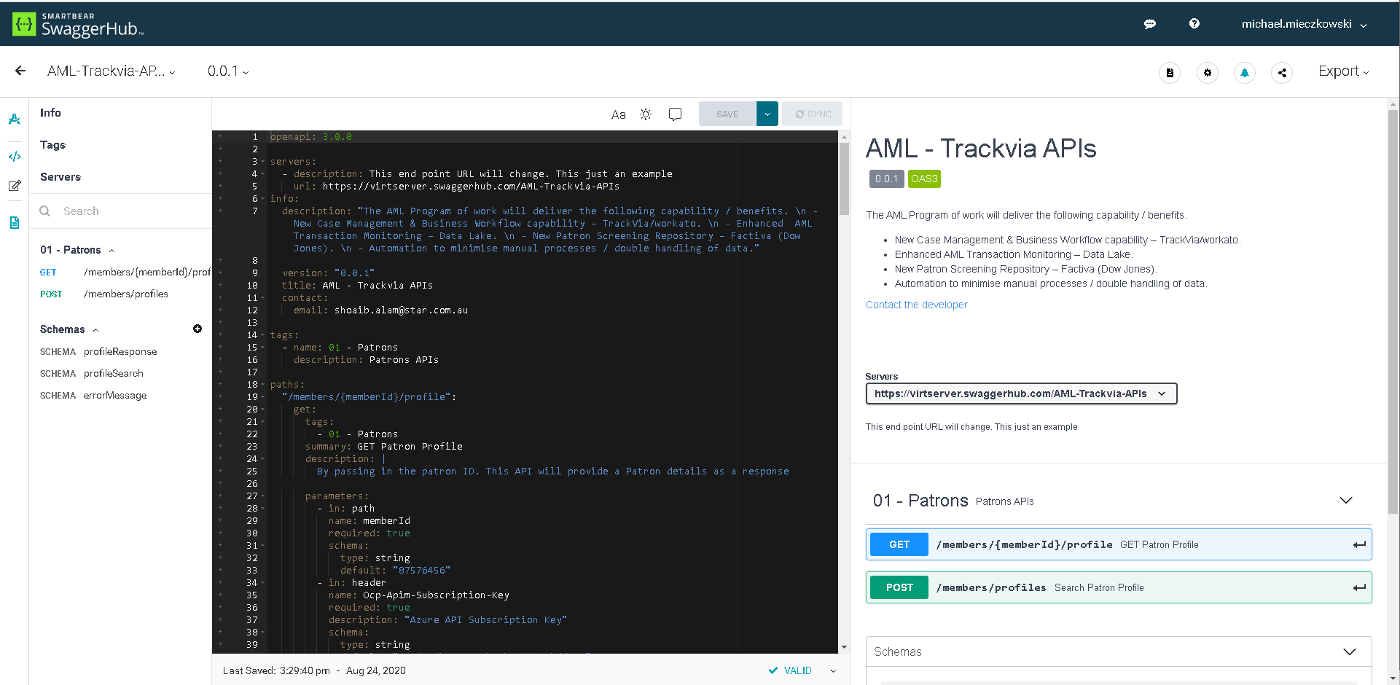
Architecture Design Review
**NEW**
SWAGGERHUB

Slide 13
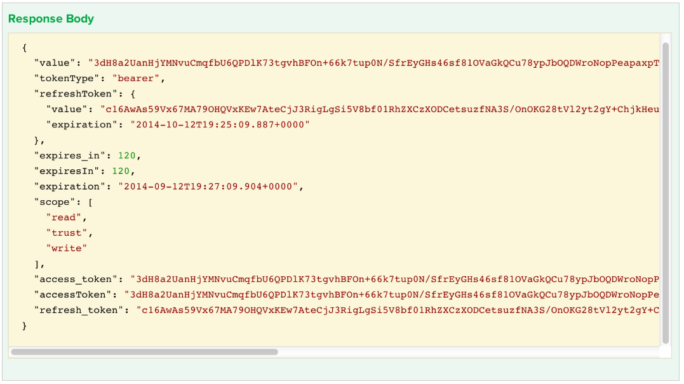
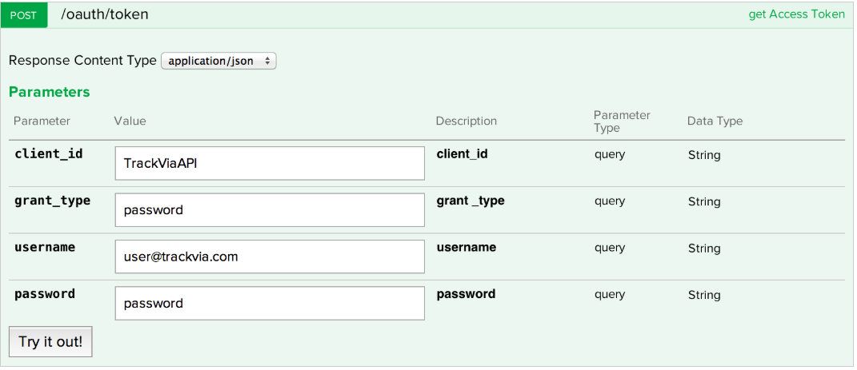
Architecture Design Review
**NEW**
TRACKVIA API
Authenticating to TrackVia API’s is via an access token. The access token, along with the user key, are used to verify that you are authorized to use the API and determine which resources you have access to.
The value at the access_token value is your access token to provide to TrackVia to authenticate yourself.
Note: the access_token will expire in the number of seconds in the expires_in value.
https://developer.trackvia.com/livedocs#!/integrations

Slide 14




Architecture Design Review
**NEW**
INTERFACE - P1 – NEW PATRON RECORD CREATION
TrackVia Azure API G/W Azure Functions Azure DL/Internal System Error & Audit
start
TV User wants to create new AML Patron & Provides Search Values
Return list of Matching Patrons
User selects relevant Patron record & return set
Return full patron record data to TV and create TV Patron record.
Note: un-Carded Patrons will be manually added to TV
Search for Matching Patron list
MDM
P1
Carded Patrons Only
Return List
Return Key
Search for selected Patron & orchestrate full data set retrieval
AZURE MDM API
MDM
&
DL
Return Record
API Security:
SSL Certificate
IP Address whitelist
Subscription key (issued to TrackVia and returned in header)
Secret/custom key (Header)
OAuth Authentication
E & A
Audit and On error
End
RESTful
(API Security model to be defined)

Slide 15


Architecture Design Review
**NEW**
INTERFACE - C1/C2 - DRAFT
TrackVia Azure API G/W Azure Functions Azure Data Lake Error & Audit
start
INTERFACE C1
Get last night TM Cases
Update TV Case ID in DL
Update TV Case result
C1
TM
Select new TM cases
Return new TM cases
Create case & return case ID
Provide delta Case updates
Call TV API to create AML cases
C1
Update with matching TV case id
TM
Return with TV Case ID
E & A
Audit or On error
TV CASE API
End
Call TV API for the case results
start
INTERFACE C2
C2
C2
Update DL with AML finding
Return with TV Case results
TM
E & A
RESTful
(API Security model to be defined)
Audit and On error
End

Slide 16

Architecture Design Review
**NEW**
INTERFACE - W1/W2 - DRAFT
TrackVia Factiva Azure API G/W Azure Functions Azure DL Error & Audit
start
Call TV for Patron List
W1
W2
AML Patron records
TV PATRON API
W1
Return Patron List
Update list with other Data Sources
WASH
LIST
Send delta patron list to Factiva
RESTful
(API Security model to be defined)
W2
New Patron Loaded into Factiva DB
sFTP
E & A
Audit and On error
end

Slide 17

Architecture Design Review
NOTE: Initial scope is for manual SMR, the next phase is to replace all Synkros generated Austrac reports (e.g. TTR) with Azure Transaction Monitoring rules engine generated Austrac reporting and sftp to Austrac (e.g. SMR, TTR, IFTIs).
**NEW**
INTERFACE - A1/A2 - DRAFT
TrackVia Austrac Azure API G/W Azure Functions Azure DL Error & Audit
RESTful
(API Security model to be defined)
start
A2
A1
Call TV for Manual SMR
A2
Return Patron List
AUSTRAC
LIST
TM
TV PATRON / SMR API
Update Austrac list with TM Data
Austrac
Website
Send combined manual and automatic AUSTRAC Reports
sFTP
A1
AUSTRAC
LIST
Submitted date/time
Submited SMR date/time & TTR reports (TBC)
E & A
Audit and On error
end

Slide 18
Architecture Design Review
TRACKVIA WEB DESIGN
TrackVia - AML
MDM
Patron Data (13,000)
Bulk Extract and Load into TrackVia
Future Scope
MDM
Data Migration
AML PATRON
MDM NO-MATCH
4
2
J12345
Patron Data
1
Patron:
J12345
ACCEPT/REJECT
John
AML Risk Rating:
HIGH
Call MDM to seed new data
First Name:
John
API
Protecht
Risk Register
Smith
Data Migration
Last Name:
Smith
PHOTO
1 Main Street
Address:
1 Main Street
13347G
Data Migration
Passport:
77867U
HIGH
Call MDM to check for updates
Protecht Attachments
(16,000 over 3 fields)
MDM
CASE
ATTACHMENTS
Data migration to load data from MDM & Protecht to TrackVia.
Patron data is displayed in TrackVia (New Patron records can be seeded from MDM data via MDM API).
TrackVia calls MDM API to get the latest Patron data.
TrackVia does a comparison of TrackVia Patron data against MDM Patron data and Flags differences.
Patron:
J12345
First Name:
John
Last Name:
Smith
3
PHOTO
Address:
1 Main Street
Passport:
13347G

Slide 19

Architecture Design Review
DATA ARCHITECTURE
PATRON
SCREENING
TRANSACTION MONITORING
CASE
AML PATRON
RECORD
Critical / High / Medium Risk
AML Patron Register
ECDD/OCDD
Workflow
INVESTIGATIONS
/ SURVEILLANCE
AUSTRAC
REPORTING
AML CASE
Activities/Task
Note: AML Patron register is a sub set of the Synkros Patron Register.

Slide 20
Architecture Design Review
Architectural Decisions
Decision | Implication
TrackVia is the new AML Case Management System | Cloud based system, with associated Cybersecurity Risks.
TrackVia is the new register for AML Critical / High / Medium risk Patrons | Data Security review i.e. Patron repository migrated from Protecht.
Factiva is the new patron screening repository. | Integration build design and effort.
Leverage Data Lake for AML Transaction Monitoring | Replace current TransWatch system
Utilise MDM for Patron Master Record (i.e. seed data for the creation of new AML Patron record) | Dependant on MDM to update Synkros information
Utilise Azure API for MDM Patron “search” and “get” information function. | Build new Azure API to expose MDM Patron functions.
Leverage Data Lake for Machine Learning | Standardise on Azure Machine Learning Pattern.

Slide 21
Architecture Design Review
Architectural Issues & Risks
Issue | Proposed Resolution
Risk | Mitigation
The business has already selected TrackVia / workato before the solution design has been endorsed, which may have unforeseen impacts on the solution. | Fast track HL design process to better communicate initial design and allow time to iterate the solution with business, IT and the Vendor.

Slide 22
Architecture Design Review
Architectural Assumptions
Assumption | Impact if False
TrackVia has the functionality to meet the business requirements | Unable to provide anticipated business value.
TrackVia has sufficient cybersecurity maturity to comply with TSEG security requirements. | Data Compliance issues.

Slide 23
Architecture Design Review
Key Dependencies & SLAs
Dependency | Resolution
SLAs | Technology Details
Highly Available
Disaster Recovery
Performance
Load
Notes:
Please indicate any requirements and/or changes in relation to the listed SLAs – Do not remove the list, but put N/A if any are not applicable

Slide 24
IT and Architecture Principles Summary
Review of conforming Principles
Solution | IT Principles | Statement
✔ | Think The Star Entertainment Group First | Solutions will consider the enterprise impact of architectural decisions
✕ | Maximise Business Value of IT Investments | Solutions will seek to maximise sharing of resources such as network, computing, storage, data and leverage strategic vendor relationships
✔ | Architecture Governance will apply across the organisation | IT will use a governance framework that ensures decisions on technology choices are against pre-defined and appropriately weighed criteria which consider both regional and enterprise factors
✔ | Secure by design | Security and compliance are embedded into business, application, data and technology architecture
✔ | Simple Solutions | IT will be as simple as possible. Where complexity is required it will be encapsulated and hidden behind an interface that is as simple as possible
✔ | Reliable, Scalable, Available and Manageable | Solutions will conform to non-functional requirements as agreed with the business customers and ensure that it will meet fundamental criteria for reliability, scalability, availability and manageability
Solution | Architecture Principles | Statement
✔ | Consider cloud first | When fit for purpose and commercially sound
✔ | Think Mobility | Applications should be built to maximise the locations and devices from which they can be used
✔ | Single Source of Truth | Where possible data (Configuration, reference data, business rules and processes) should be stored once and shared across the enterprise
✔ | Modular Components | Services will be designed to maximise enterprise wide reuse
✔ | Reuse before Buy, Buy before Build | The approach to deployment of new IT applications, services and infrastructure is to reuse existing capability. If existing capability does not meet required capability then a “buy” option should be considered before a “build” option unless considered business strategic
✔ | Design for Change over Design to Last | Design applications and systems so they can evolve over time to address new requirements and challenges
Notes:
Remove ticks and/or crosses under ‘Solution’ as applicable for your solution

Slide 25
Architecture Design Authority
ARIM Rating Assessment
Solution | Assessment Question | ARIM Rating
✔ | Are there new applications being introduced? | 3
✔ | Are there new interfaces being created inside the company? | 1
✔ | Are there new interfaces with outside entities being created? | 3
✔ | Are there new business workflows being introduced? | 2
✔ | Are there increased Business Volumes? | 2
✔ | Are there changes to SLAs? | 3
✔ | Are there changes to underlying infrastructure? | 2
✔ | Are there any violations of key architecture principles / standards? | 2
Notes:
Remove ticks and/or crosses under ‘Solution’ as applicable for your solution

Slide 26
Architecture Design Review
Architecture Design Authority Decision
Justification for Design Authority Decision
N
Conforms to Architecture Principles (Y/N)
Overall Comments:
TrackVia is not a strategic IT platform (refer to Gartner Magic Quadrant diagram).
Confirms to AML Business 5 Year plan.
5
Conforms to the 5 Year Plan (Y/N)
3
Initial ARIM rating
A
Rating: Accept (A), Accept with conditions (AC), Reject (R) or (E) Exception
Notes:
This slide is to be completed by the chair of the ADA at the time of presentation – Not prior

